Slide 1
2019 Travel Scholarships

Slide 2
Financial Support
CAPER would like to thank the following organizations and contributors for their financial support of the
2019 CAPER Travel Scholarships:
AbbVie, Inc.
Dr. Edward D. Purich, ChiRhoClin, Inc.

Slide 3
Adeyinka Adejumo, MD, MS North Shore Medical Center
National estimates of the trends and outcomes of Protein-Energy Malnutrition among patients with chronic pancreatitis.

Slide 4
Amir Gougol, MD University of Pittsburgh
Multi-Organ Failure is the Strongest Determinant of Poor Clinical Outcomes in Acute Pancreatitis. (APPRENTICE Study Group)

Slide 5
Anna Phillips, MD, MS University of Pittsburgh
Persistent SIRS and Non­Alcohol Etiology of AP are associated with Oral Feeding Intolerance in AP: Results From an International, Multicenter, Prospective Cohort Study.

Slide 6
Venkata Sandeep Akshintala, MD Johns Hopkins Hospital
Cystic fibrosis transmembrane conductance regulator modulators reduce the risk of recurrent acute pancreatitis among adult patients with pancreas sufficient cystic fibrosis

Slide 7
Naylor Brownell, MD Fellow Physician, Pediatric Gastroenterology and Nutrition Children's Hospital of Philadelphia
Exocrine Pancreatic Function, Genetic Variants, and Risk Factors in a Cohort of Subjects with Chronic Pancreatitis

Slide 8
Peter Farrell, MD, MS Clinical Fellow, Division of Gastroenterology, Hepatology, and Nutrition Cincinnati Children’s Hospital Medical Center
Validation and Optimization of an Early Predictor Model for Pediatric Acute Pancreatitis

Slide 9
Pedram Paragomi, MD University of Pittsburgh
Dynamic analysis of patients with acute pancreatitis: validation of a new predictive tool for severity assessment in a large prospective cohort.

Slide 10
Santiago Manrique-Bedoya, MD Clinical Fellow, Division of Gastroenterology, Hepatology, and Nutrition University of Texas at San Antonio
Computational modeling of plasmonic photothermal therapy in pancreatic tissue: A precursor to nanoparticle-mediated pancreatic cancer treatment.

Slide 11
Balazs Nemeth, MD, PhD University of Szeged, Hungary
Mutations in the 5’ upstream region of Chymotrypsinogen C gene are not associated with chronic pancreatitis.

Slide 12
Eszter Hegyi, MD, PhD University of Pecs, Hungary
Assessing the clinical significance of PRSS1 intronic variants.

Slide 13
Lan Li, MD University of West China Hospital, China
Early Rapid Fluid Therapy is Associated with Increased Risk of Persistent Organ Failure in Acute Pancreatitis Patients with Hemoconcentration after Initial Management.

Slide 14
Kendall McEachron, MD T32 Research Fellow University of Minnesota
Changes in inflammatory cytokine levels in the acute and subacute phases of islet engraftment after total pancreatectomy and islet autotransplantation (TPIAT).

Slide 15
Aslam Syed, MD Gastroenterology Fellow Allegheny Health Network
Chronic pancreatitis is associated with increased cardiovascular mortality: a population-based analysis.

Slide 16
Ayesha Kamal, MD John Hopkins University
Development, validation of a Post-ERCP pancreatitis risk calculator and machine learning based decision making tool for prophylaxis selection.

Slide 17
Francisco Valverde-Lopez, MD, PhD La Merced Hospital, Spain
Clinical and endosonographic factors related to recurrence in idiopathic acute pancreatitis.

Slide 18
Kishore Vipperla, MD, University of Pittsburgh
Pain “Burn-out” During the Natural Course is Independent of the Duration of Chronic Pancreatitis (CP).

Slide 19
Mahya Faghih, MD, Post Doc John Hopkins University
Pain modulatory phenotypes differentiate chronic pancreatitis patients with distinct clinical pain profiles.

Slide 20
Nikhil Thiruvengadam, MD Clinical Fellow University of California San Francisco
Tacrolimus and Indomethacin are Safe and Effective at Reducing Post-ERCP Pancreatitis in Orthotopic Liver Transplant Patients Undergoing ERCP.

Slide 21
Laurel Branch, MD Internal Medicine Fellow The Medical University of South Carolina
Diagnostic Imaging in Pancreatic Ductal Adenocarcinoma.

Slide 22
John George, MD Yale New Haven Health
Incidence of pancreatitis with the use of immune checkpoint inhibitors (ICI) in advanced cancers: A systematic review and meta-analysis.

Slide 23
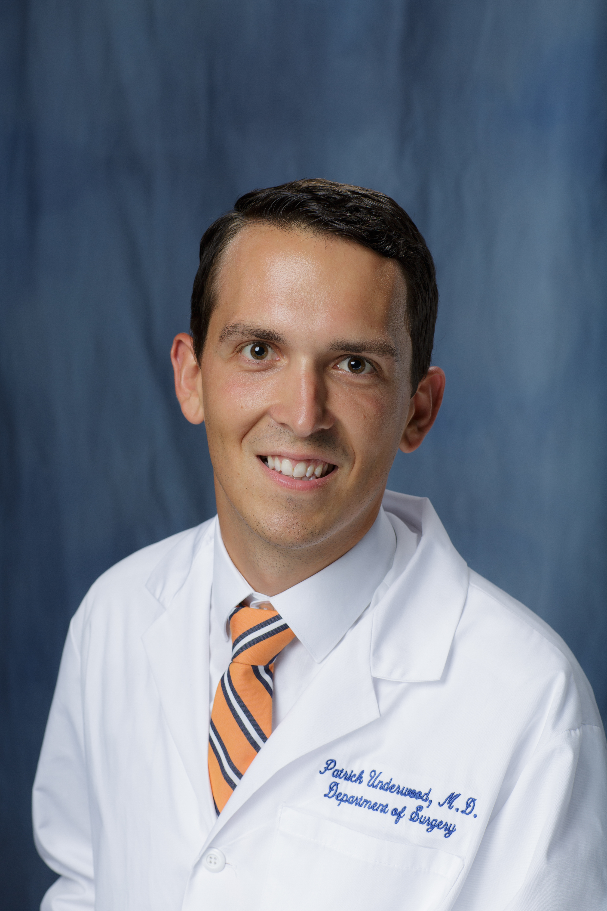
Patrick Underwood, MD University of Florida
Feasibility and performance of a protein signature assay in EUS-FNA of suspected pancreatic adenocarcinoma.

